Slide 1


2024
SYSTEM-WIDE RESULTS REPORT OF THE REGIONAL COLLABORATIVE PLATFORM
FOR LATIN AMERICA AND THE CARIBBEAN

Slide 2


Overview of the RCP LAC
and its working mechanisms
A way forward
Key challenges at the regional level
Highlights of system-wide results
at the regional level
1.
2.
3.
4.
2

Slide 3

Overview of the RCP LAC
and its working mechanisms

Slide 4
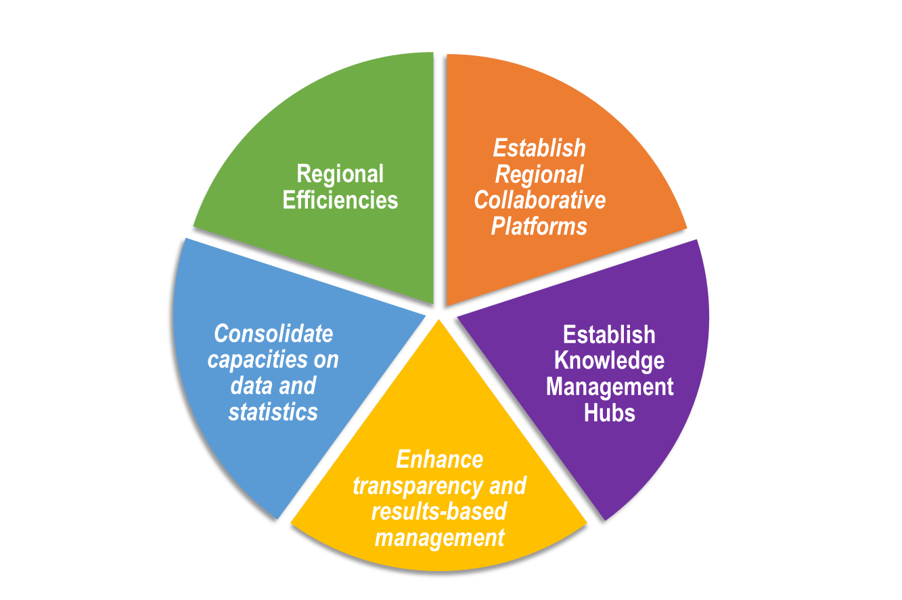
Regional Collaborative Platform
^{Framework}
Established following its 2020 Operational Activities Segment, the United Nations Economic and Social Council (ECOSOC) adopted resolution E/RES/2020/23 in July 2020, endorsed in General Assembly resolution 74/297.
Responds to the Secretary-General’s five recommendations to guide the restructuring of the United Nations development system at the regional level.
4

Slide 5
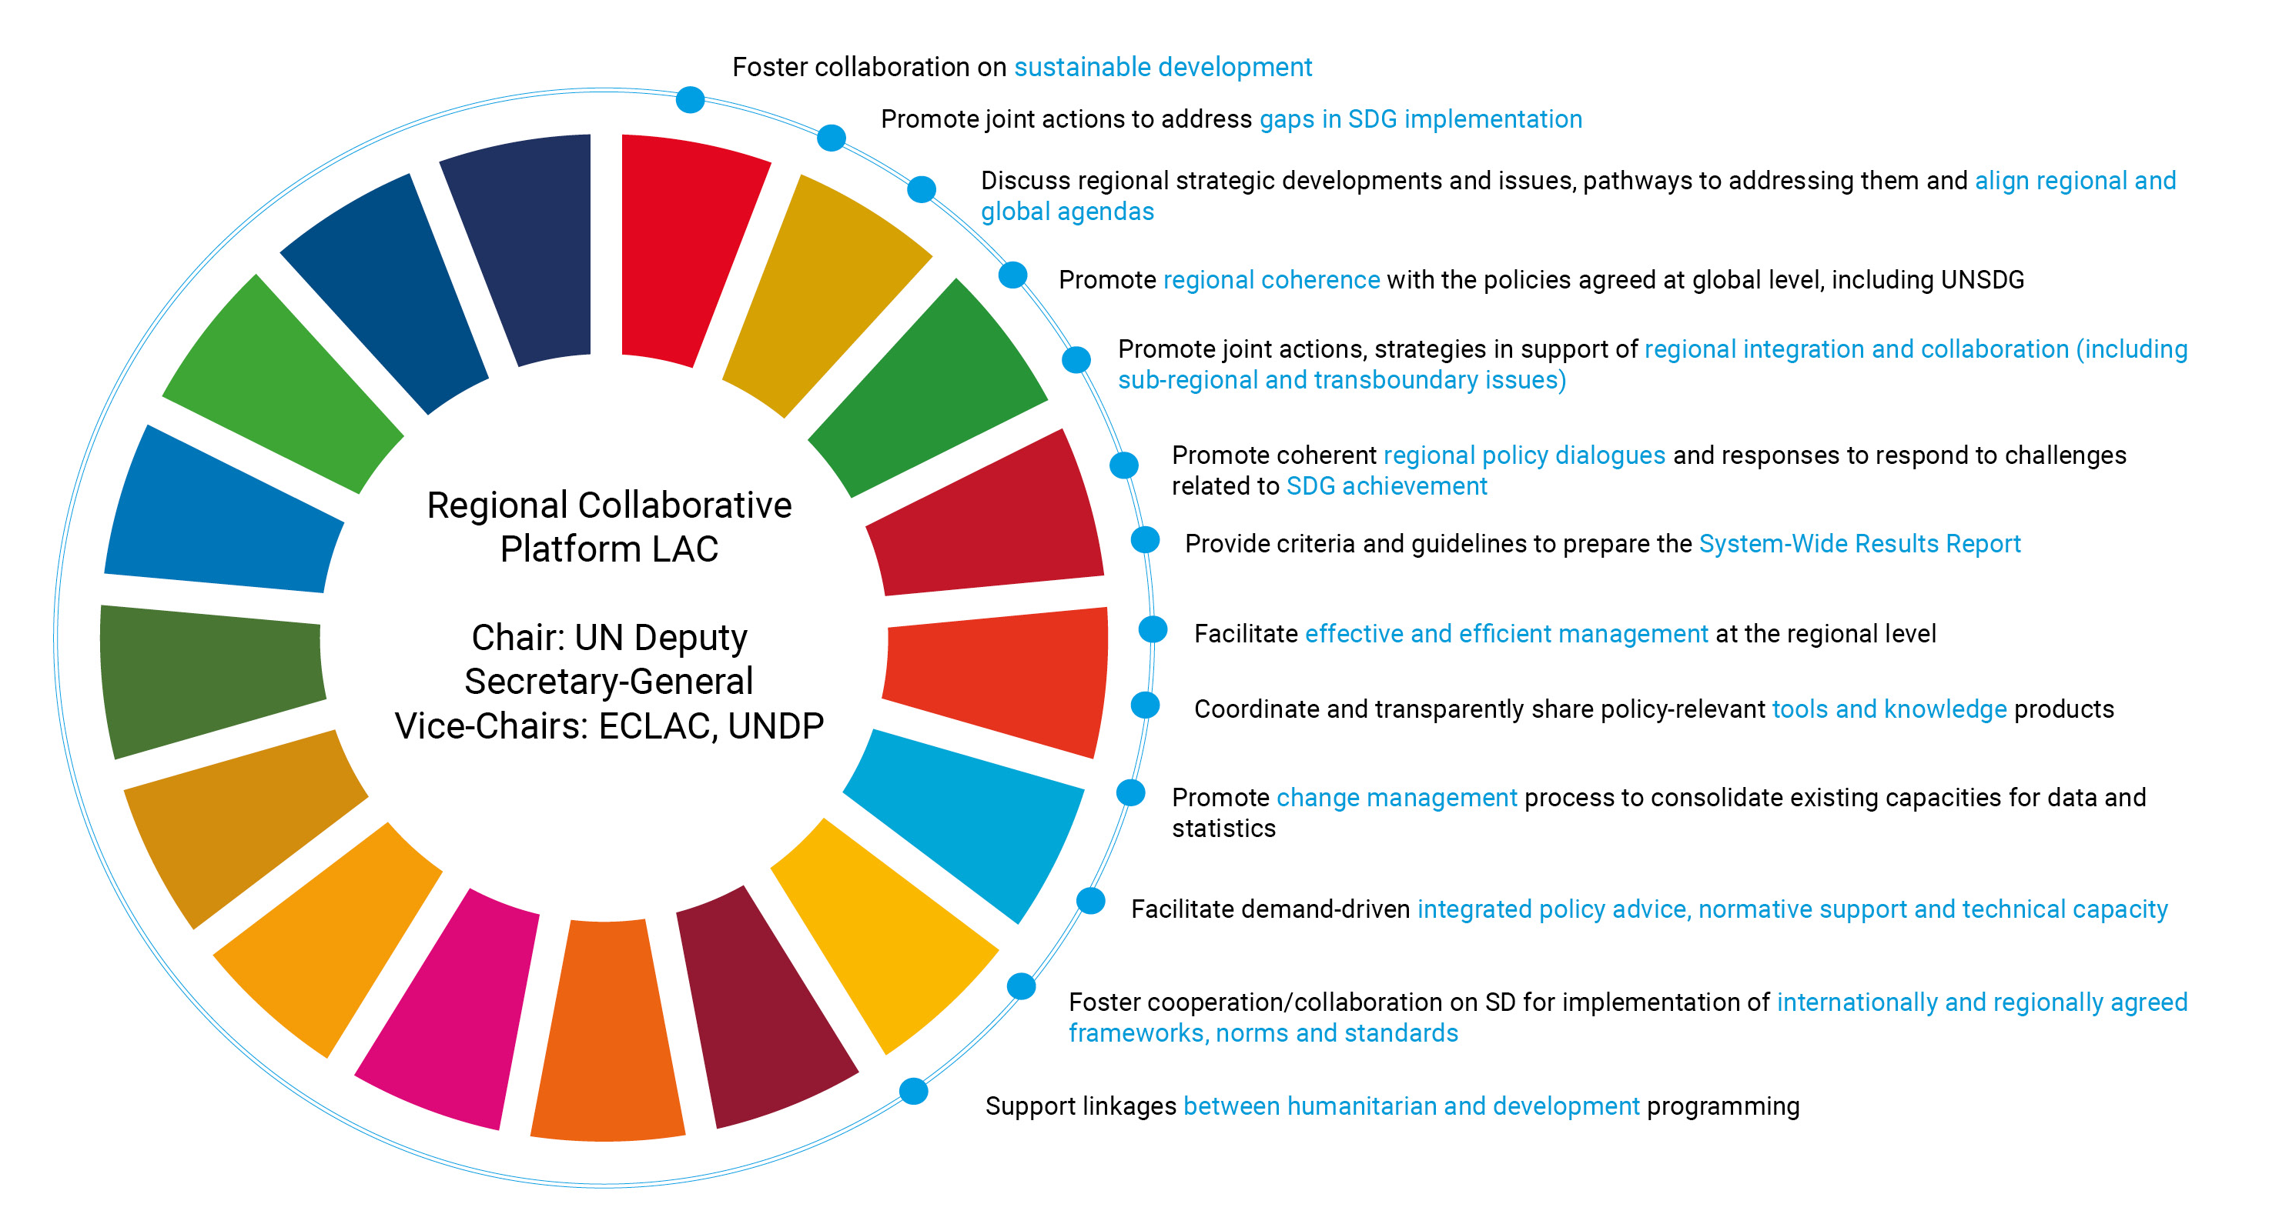
Key functions of the Regional Collaborative Platform
for Latin America and the Caribbean
5
*As established in the Management and Accountability Framework

Slide 6
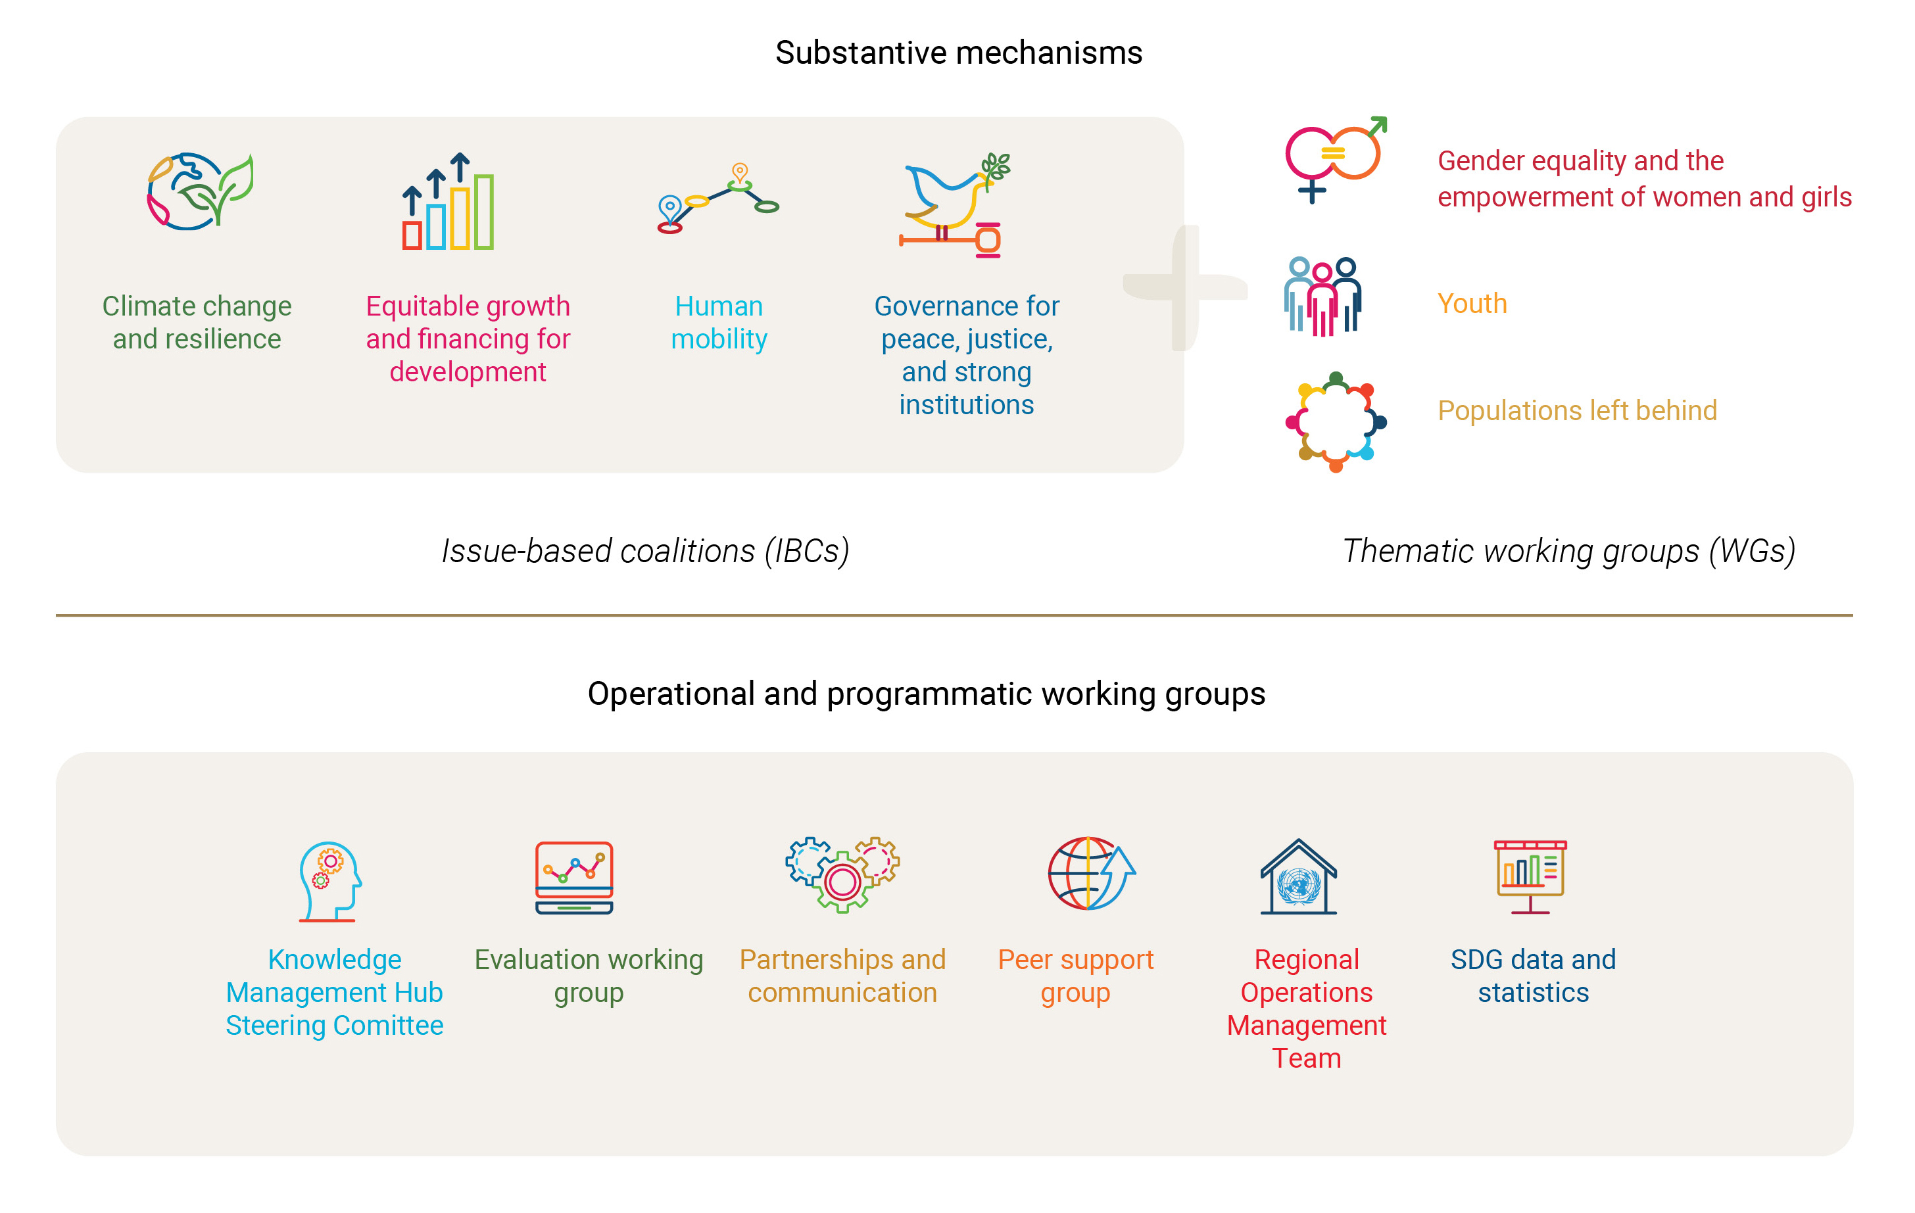
Regional Collaborative Platform 2.0.
Working Mechanisms
6

Slide 7
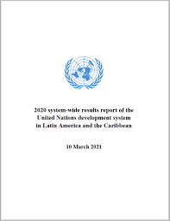
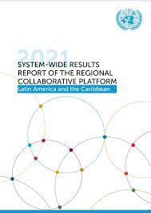
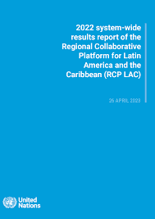
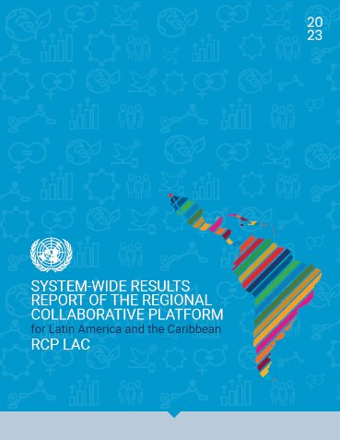
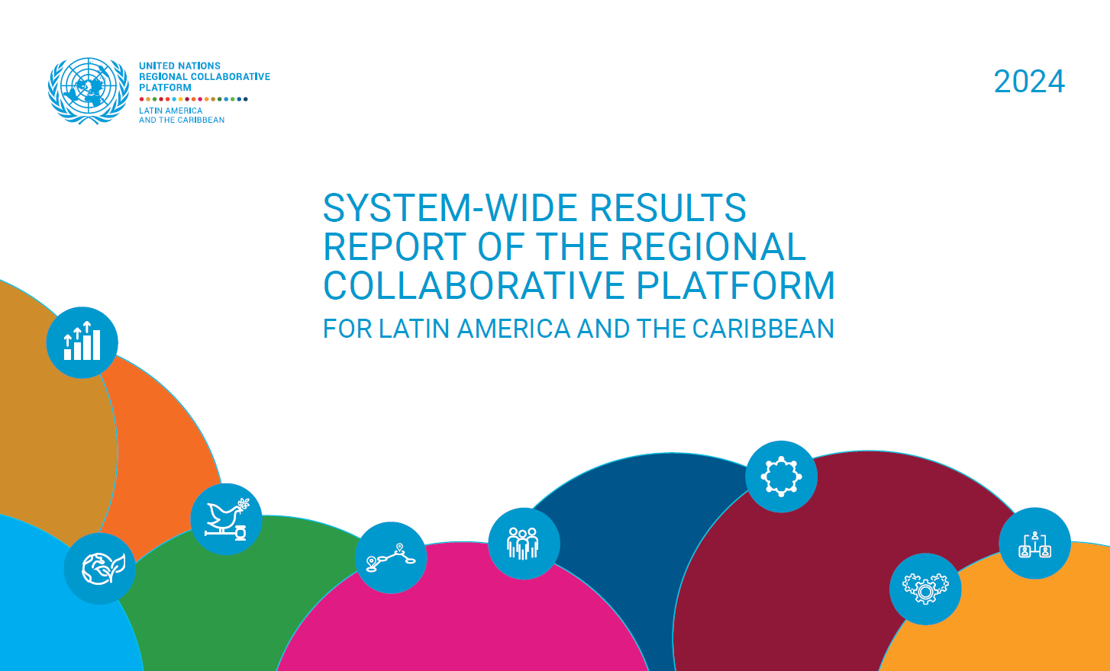
Regional Collaborative Platform
Annual system-wide results reports
2020
2021
2022
2023
2024
rcplac.org
7

Slide 8

Key challenges
at the regional level

Slide 9



2024 System-wide results report
Overview of the regional context
Equitable growth and financing for development
Social protection
Food systems
LAC has a projected GDP growth of 2.2 % for 2024 and 2.4 % for 2025.
172 million people do not have enough income to meet their basic needs.
LAC has an estimated US$ 99 billion per year spending gap for the main development priorities.
LAC has demonstrated resilience and innovation in advancing the SDGs and has begun developing and enhancing sustainable finance frameworks.
Women’s labour participation is 23 percentage points lower than men’s.
Informality in labour markets disproportionally affects women, youth, migrants, rural populations and older persons.
73% of the people in poverty and 68% in extreme poverty live in urban areas.
2.9 million people stopped suffering from hunger in LAC in 2024.
LAC continues to register the highest cost of a healthy diet.
66 million people cannot buy a basic food basket in the region.
9

Slide 10



2024 System-wide results report
Overview of the regional context
Peace, justice and strong institutions
Gender equality
Education
34% of all homicides globally occur in LAC, while the region only represents 8% of the global population.
8 of the 10 countries with the highest homicide rates in the world are in LAC.
The perception of democracy has improved from 48% in 2023 to 52% in 2024.
1 in 4 Latin Americans declares themselves indifferent to the type of regime in their country.
2 in 3 women aged 15-49 have been victims of violence.
18% of women experienced violence in childhood.
12% of women have suffered sexual violence, twice the global average.
At least 3,897 women were victims of femicide or feminicide in LAC.
There are at least 11 gender-related killings of women every day in LAC.
Nearly 10.3 million children are out of school in the region.
Inequities in digital access exacerbate learning gaps.
10

Slide 11


2024 System-wide results report
Overview of the regional context
Climate change, biodiversity and pollution
Human mobility
LAC accounts only for 10% of global greenhouse gas emissions, primarily from land use and agriculture.
LAC is the 2nd most disaster-prone region in the world.
LAC accounts for 53% of the world’s economic losses due to disasters.
6 of the 10 countries with the highest economic losses from disasters relative to GDP are in LAC.
Movements of refugees and migrants in 2024 were driven by political instability, the search for economic and employment opportunities, the impacts of organized crime and violence, and climate change.
Key challenges include access to fair and efficient asylum systems, the risk of statelessness and protection gaps along routes, human trafficking and a growing anti-migration narrative that erodes human dignity and limits socioeconomic insertion.
11

Slide 12

Highlights of system-wide results at the regional level

Slide 13
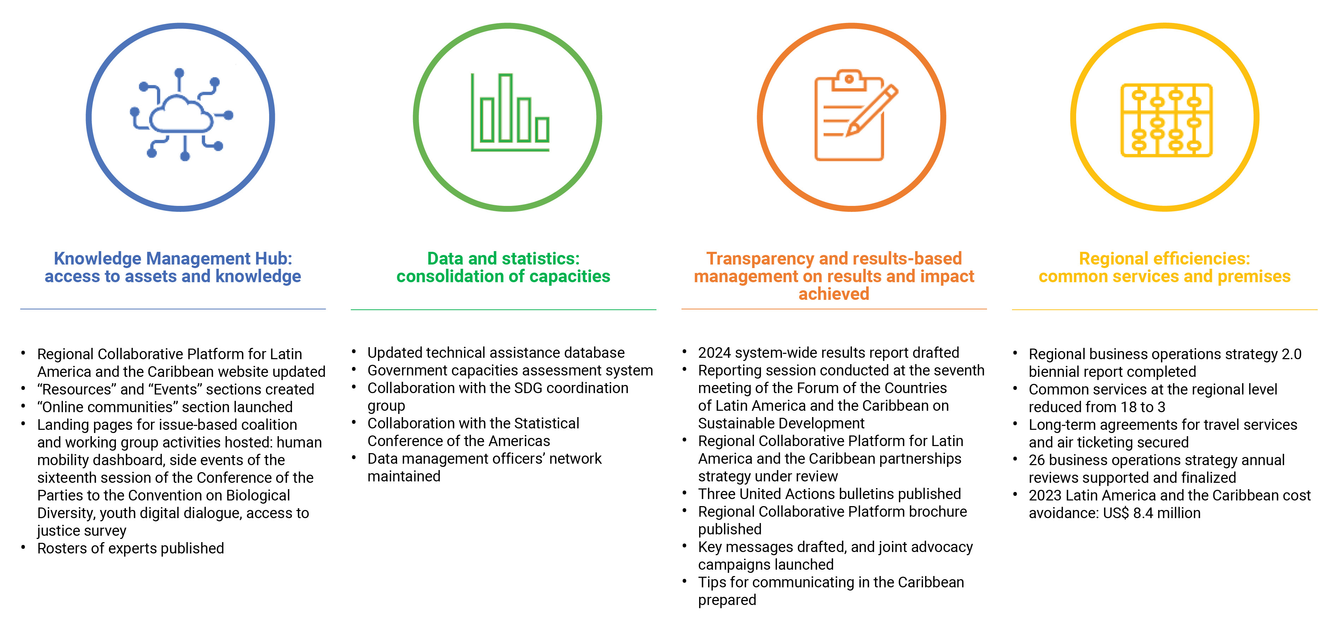
^{2024 Key Achievements}
Highlights on the implementation of the regional review
13

Slide 14




^{2024 Key Achievements}
^{Issue-based Coalitions}
Climate Change and Resilience
Capacity building and knowledge products on climate change, disaster risk reduction, biodiversity, resilience, and gender integration.
Governance for Peace, Justice, and Strong Institutions
UN iLabCC for SDG 16 coordination.
Note on incarceration issues and the penal system.
Innovative solutions for access to justice.
Equitable Growth and Financing for Development
Development finance initiatives and economic policy discussions.
Inclusive Growth Tracker to evaluate labour market policies.
Human Mobility
Regional United Nations-coordinated approach to migration and displacement.
Quarterly data reports on mixed movements.
14

Slide 15



^{2024 Key Achievements}
^{Thematic Working Groups}
Gender Equality and the Empowerment of Women and Girls
Regional Gender Equality Profile.
Messages for human rights, equity, and inclusion for women, girls, and LGBTQI+ individuals.
Youth
Regional dialogue to amplify youth voices and discuss sustainable solutions at key events such as the Youth20Summit and Summit for the Future.
Populations Left Behind
Integration of human rights, SDGs, and leaving no one behind principles in UN country team programming.
15

Slide 16



^{2024 Key Achievements}
Operational and programmatic support
Peer Support Group
UNSDCF strategic support and capacity building.
Cross-regional collaboration.
Foresight thinking integration into planning processes.
SDG Data and Statistics
Updated technical assistance and government capacities assessment systems.
Strengthened data management network.
Evaluation
UNSDCF evaluation support in 5 countries.
Enhanced national evaluation systems and UNCT programming.
16

Slide 17



^{2024 Key Achievements}
Operational and programmatic support
Regional Efficiencies
US$ 8.4M savings through optimized services.
26 BOS reviews and regional Business Operation Strategy biennial report.
Knowledge Management
RCP LAC website update with new Resource and Events sections.
Updates on IBCs and WGs activities.
Partnerships and Communication
Tips for communicating in the Caribbean.
Joint narrative and key messages on the 2030 Agenda and SDGs ahead of global events.
RCP LAC information materials.
17

Slide 18
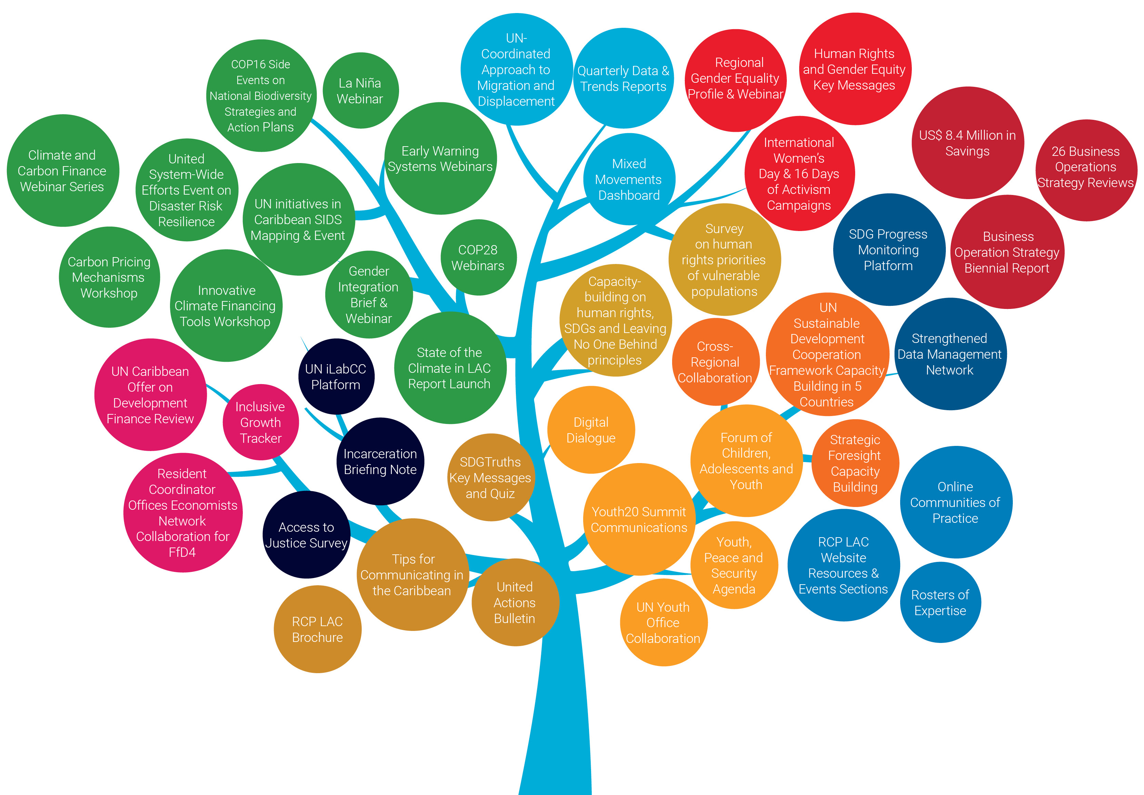
2024 Highlights
of RCP LAC Issue-Based Coalitions and Working Groups
18

Slide 19
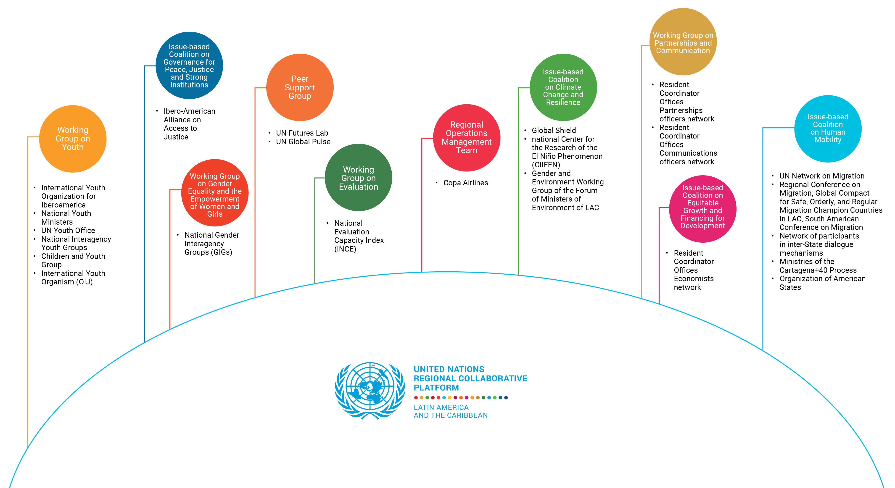
Engagement with External Stakeholders
20
19

Slide 20




^{2024 Key Achievements}
^{Other regional priorities}
Education
Future of Education at the 2024 Regional Forum on Education Policy.
Learning Action called on learning poverty and foundational skills.
Sustainable Education High-level dialogue on financing and education reform.
Health
Health investment Joint document on policy gaps for SDG achievement.
HIV Expanded access to testing, treatment and prevention.
Maternal and adolescent health Strategies for maternal mortality reduction and adolescent healthcare.
Food Systems
The UN Task Force capacity-building, partnerships and Convergence Initiative.
Joint report “Financing for Food Security and Nutrition in LAC”.
Digital Transformation
AI UN-led discussion group fostering joint efforts on AI and development.
EU-LAC Digital Alliance High-level dialogues on connectivity, inclusion, AI, and synergies with global initiatives.
20

Slide 21

A way forward

Slide 22
Regional Collaborative Platform
^{2025 Key Priorities}
1
2
3
Enhancing regional support for the acceleration on the achievement of the SDGs at the subregional level and in cross-border and transboundary contexts, including those identified through the Forum of the Countries of Latin America and the Caribbean on Sustainable Development and the High-level Political Forum on Sustainable Development.
Building partnerships with regional partners, international finance institutions and other subregional
development actors to advance the implementation of the 2030 Agenda and the SDGs in the region, prioritizing human mobility and transnational organized crime as key areas for partnership building.
Promoting regional coherence regarding global priorities and initiatives such as the Pact for the Future, the Global Digital Compact and the Declaration on Future Generations.
22

Slide 23


Thank you

